Slide 1

C Developer
Advanced Concepts

Slide 2

Course Objectives
Make socket connection
Make a TCP/UDP server and client
Manipulate threads
Approach the basics of the concurrent programming

Slide 3

Course Plan
1. Sockets
2. Threads

Slide 4

1. Sockets

Slide 5

1. Sockets
Introduction
Sockets are data flows allowing local or remote machines to communicate over the network
They use TCP or UDP, and implement many protocols such as IMAP, HTTP, FTP, SSH, etc.
They are available on all platforms and are cross language

Slide 6
1. Sockets
Introduction
Each machine creates a socket
Each socket will be associated to a port
The two sockets will be explicitly connected
Each machine reads/writes to its socket
The data goes from one socket to another through the network
Once completed, each machine closes its socket

Slide 7
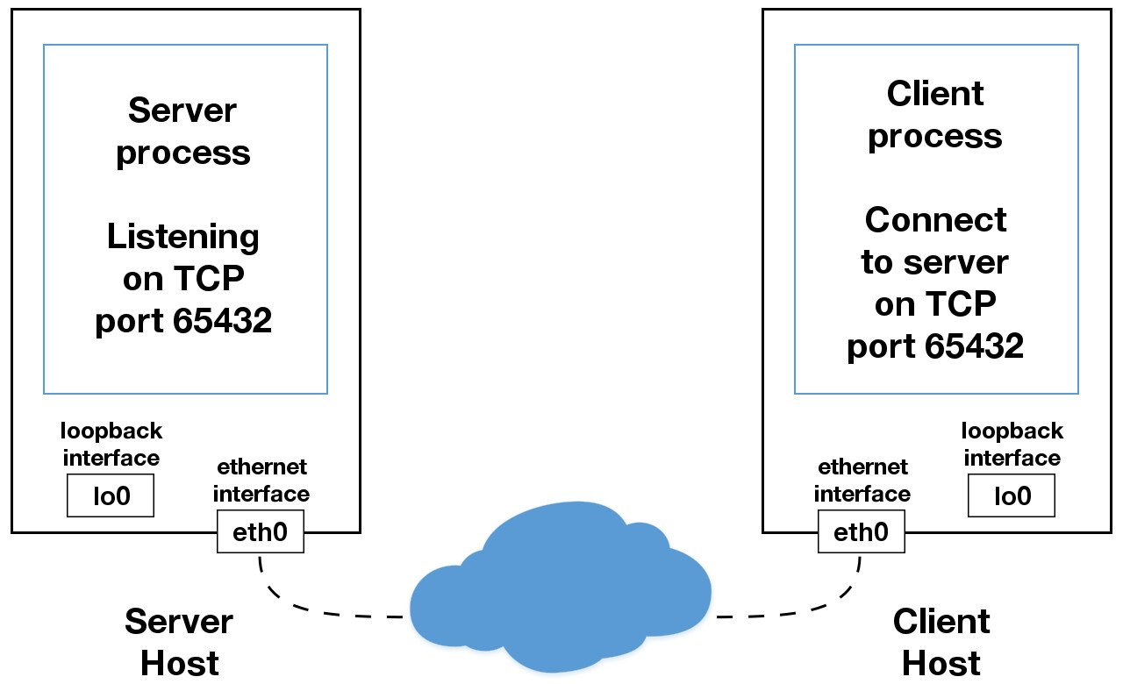
1. Sockets
Introduction
Notes:
Source: https://realpython.com/python-sockets/

Slide 8
1. Sockets
Introduction
Each operating system implements them
The same functions are used for the overall operation
Some functions and libraries can be added to meet the specificities
To use, it is necessary to add the libraries, define the structures then the parameters

Slide 9
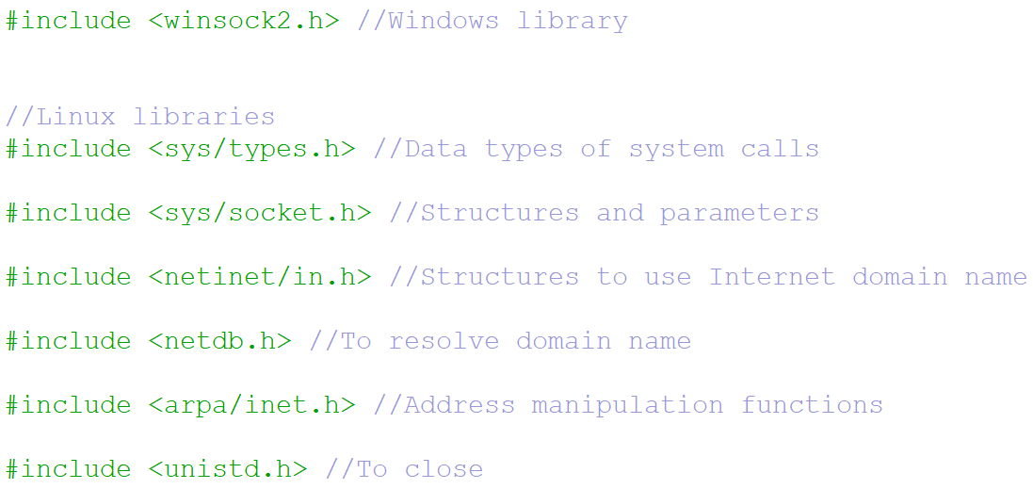
1. Sockets
Libraries

Slide 10
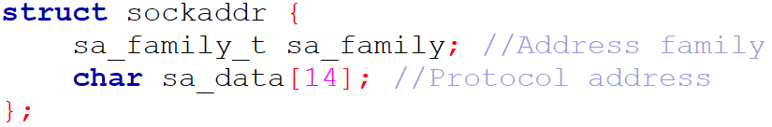
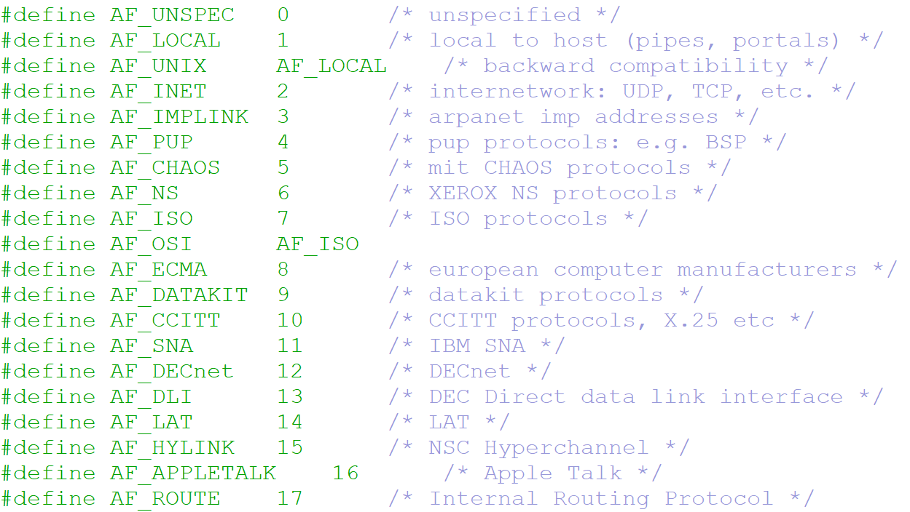
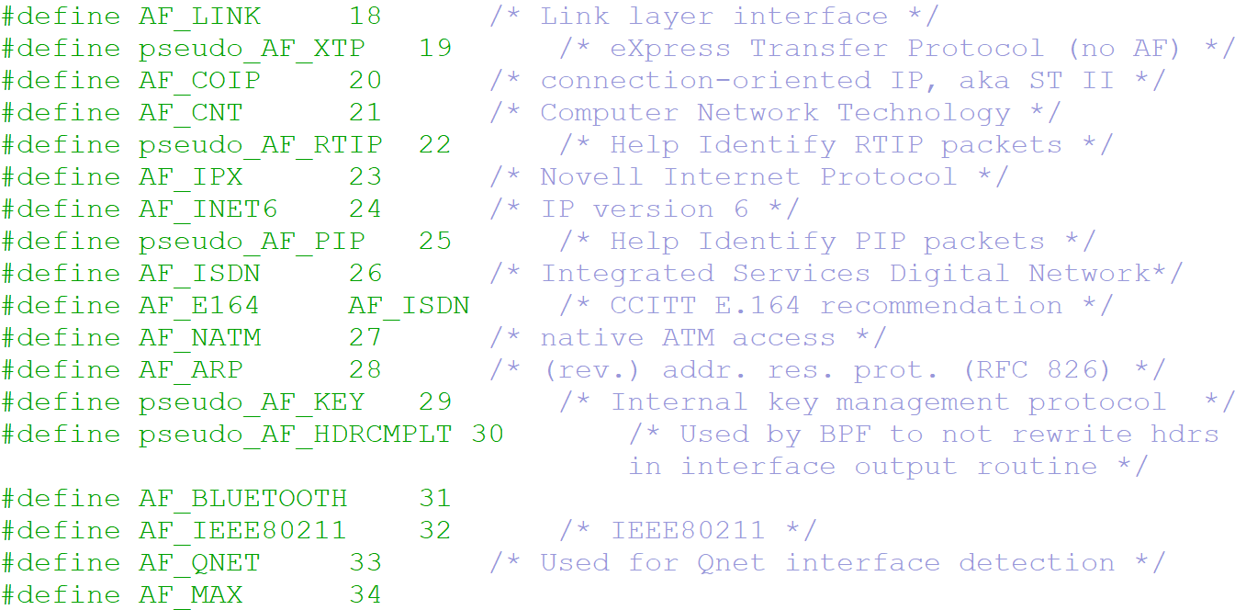
1. Sockets
Structures
Basic information:
Address families:

Slide 11
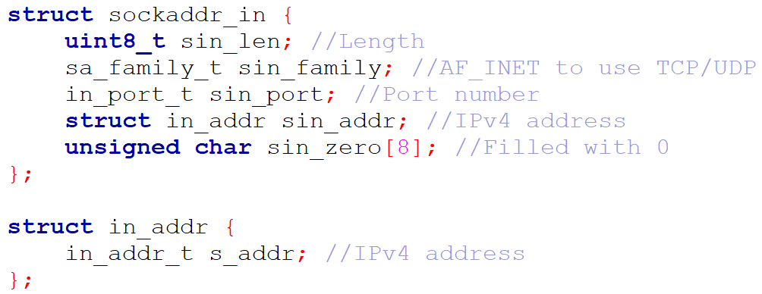
1. Sockets
Structures
IPv4 address format:

Slide 12
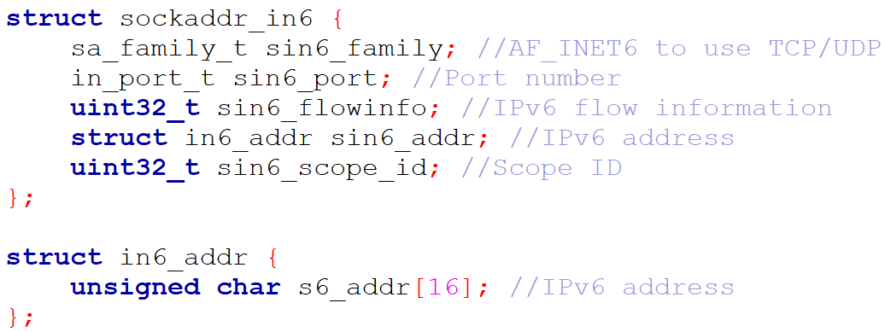
1. Sockets
Structures
IPv6 address format:

Slide 13
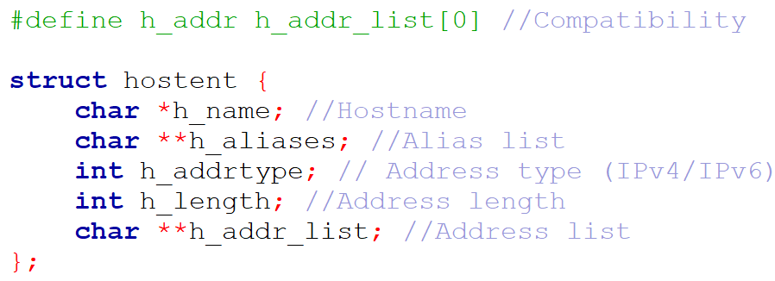
1. Sockets
Structures
Domain name:

Slide 14
1. Sockets
Functions
TCP Client
TCP Server
socket(…)
socket(…)
Information
bind(…)
Setup
listen(…)
connect(…)
accept(…)
Connection
send(…)
recv(…)
Transfer
recv(…)
send(…)
close(…)
close(…)
Close

Slide 15
1. Sockets
Functions
UDP Client
UDP Server
socket(…)
socket(…)
Information
bind(…)
Setup
sendto(…)
recvfrom(…)
Transfer
recvfrom(…)
sendto(…)
close(…)
close(…)
Close

Slide 16
1. Sockets
Functions
To define a socket, use the socket function
Function signature:
– Define IPv4 (AF_INET) or IPv6 (PF_INET6)
– Define TCP (SOCK_STREAM) or UDP (SOCK_DGRAM)
– It returns the socket descriptor or -1 in case of failure

Slide 17

1. Sockets
Functions
To close the socket descriptor, use the close function
Function signature:
– It returns 0 or -1 in case of failure

Slide 18

1. Sockets
Functions
To send using connected TCP mode, use the send function
Function signature:
– It returns the number of characters sent or -1 in case of failure

Slide 19
1. Sockets
Functions
To send using unconnected UDP mode, use the sendto function
Function signature:
– It returns the number of characters sent or -1 in case of failure

Slide 20

1. Sockets
Functions
To receive using connected TCP mode, use the recv function
Function signature:
– It returns the number of characters received or -1 in case of failure
Notes:
sizeof(buff)-1 to remove “\0”

Slide 21
1. Sockets
Functions
To receive using unconnected UDP mode, use the recvfrom function
Function signature:
– It returns the number of characters received or -1 in case of failure
Notes:
sizeof(buff)-1 to remove “\0”

Slide 22
1. Sockets
Functions
To attach a socket directly to a port and an address, use the bind function
Function signature:
– It returns 0 or -1 in case of failure

Slide 23
1. Sockets
Functions
To connect the socket to a server address, use the connect function
Function signature:
– It returns 0 or -1 in case of failure

Slide 24
1. Sockets
Functions
To mark the socket as passive mode and set the size of the connection queue, use the listen function
Function signature:
– It returns 0 or -1 in case of failure

Slide 25
1. Sockets
Functions
To accept a new connection, use the accept function
Function signature:
– It returns the socket descriptor or -1 in case of failure

Slide 26
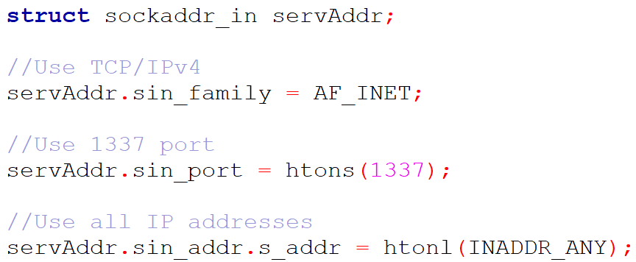
1. Sockets
Definitions
Define a sockaddr_in to create an IPv4 server:

Slide 27
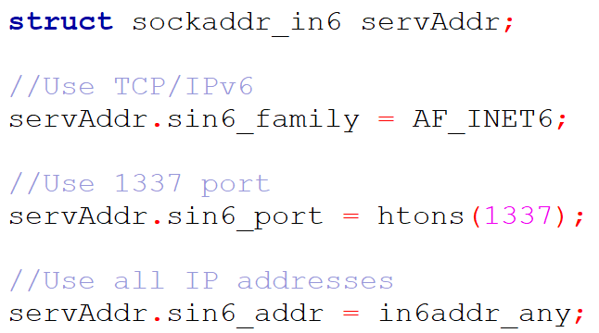
1. Sockets
Definitions
Define a sockaddr_in6 to create an IPv6 server:

Slide 28
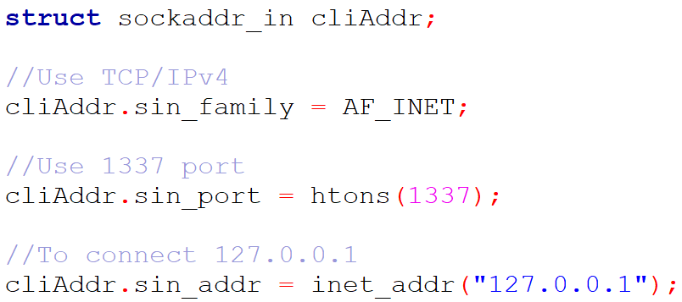
1. Sockets
Definitions
Define a sockaddr_in to create an IPv4 client:

Slide 29
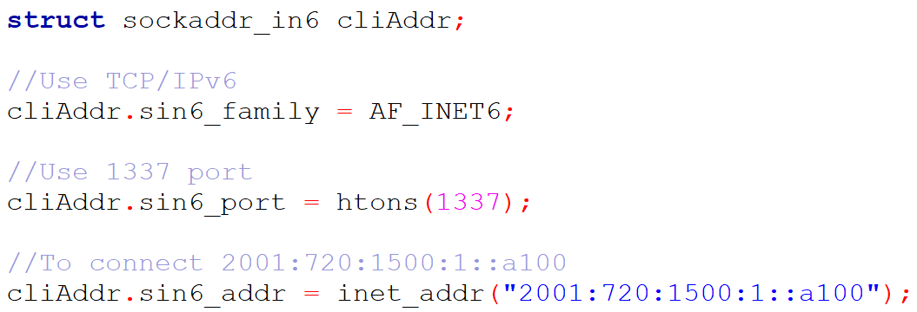
1. Sockets
Definitions
Define a sockaddr_in6 to create an IPv6 client:

Slide 30
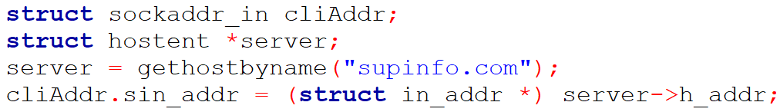
1. Sockets
Definitions
Retrieve an address using the hostname:

Slide 31
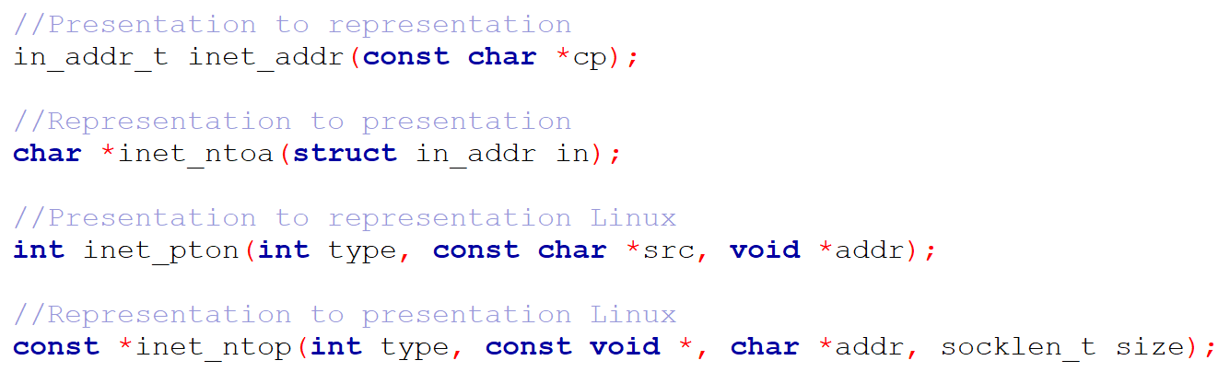
1. Sockets
Definitions
Convert IPv4 or IPv6 address representation:

Slide 32
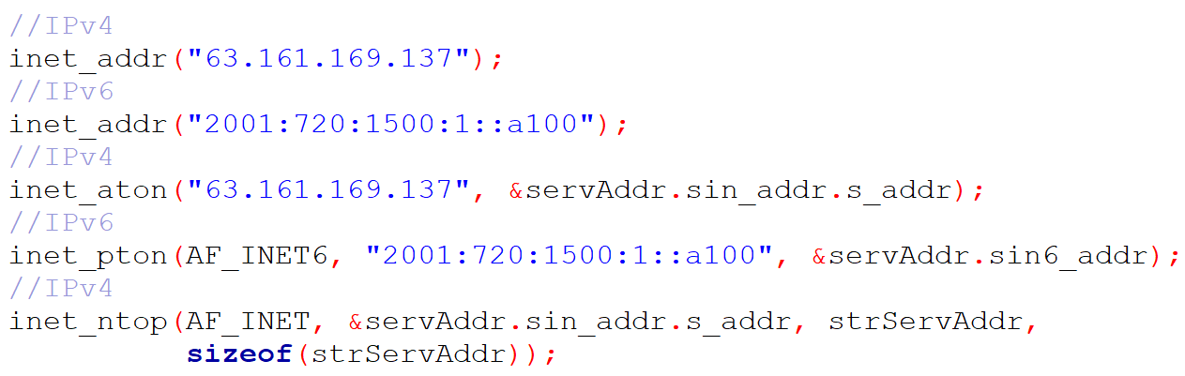
1. Sockets
Definitions

Slide 33


1. Sockets
Windows specificities
Start by loading the DLL:
Finish by unloading the DLL:

Slide 34

1. Sockets
Windows specificities
Many structures are redefined:
– sockaddr_in becomes SOCKADDR_IN
– sockaddr becomes SOCKADDR
– in_addr becomes IN_ADDR
Socket descriptor is not an int but a SOCKET
– Define for UNIX:

Slide 35
1. Sockets
Windows specificities
To close SOCKET, use:
– Define for UNIX:

Slide 36
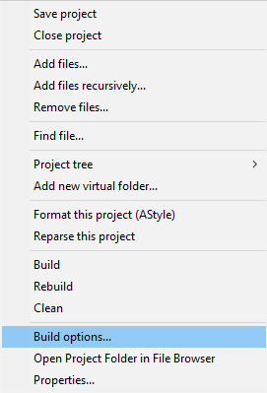
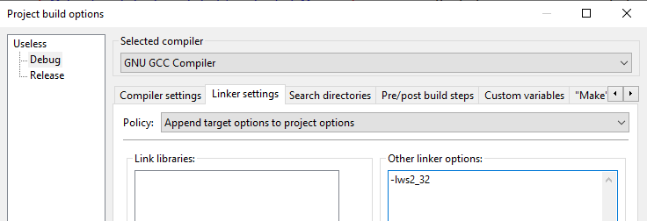
1. Sockets
Windows specificities
Add the “-lws2_32” linker option in your build settings:

Slide 37

1. Sockets
To go further
To transfer a quantity of data of unknown size, it must be possible to transfer a buffer several times:
– JSON
– Files
– Conversations
– etc.

Slide 38
1. Sockets
To go further
To check the state change of a socket, use the select function
Function signature:
– To make a non-blocking server/client
– To manage many clients
– It returns the number of socket descriptors that have changed, 0 in case of timeout, or -1 in case of no change
– It removes from fd_set, sockets that have not been changed
Notes:
Take sock+1 to have all open sockets

Slide 39

1. Sockets
To go further
To monitor a set of socket descriptors, use fd_set
– Add a socket descriptor to a set:
– Remove a socket descriptor from a set:
– Clear a set:
– Check if the socket descriptor is in the set after select:

Slide 40
1. Sockets
To go further
HTTP client example
socket(…)
connect(…)
FD_ZERO(…)
send(…)
FD_SET(…)
select(…)
If FD_ISSET(…)
else
Int i = recv(…)
close(…)
i = 0
i > 0

Slide 41
1. Sockets
To go further
HTTP server example
FD_ZERO(…)
socket(…)
FD_SET(all)
bind(…)
select(…)
listen(...)
If FD_ISSET(...)
If FD_ISSET (cli[x])
else
accept(cli[x])
int i = recv(cli[x])
i = 0
i > 0
send(cli[x])
close(cli[x])

Slide 42

1. Sockets
Exercise
Ask the user for a domain name
Use only port 80 and GET requests
Save the result of the query to a file

Slide 43

1. Sockets
Questions

Slide 44

2. Threads

Slide 45
2. Threads
Overview
Each application running on a computer is associated with a process representing its activity
This process is associated with a set of custom resources such as memory space, CPU, etc.
These resources will be dedicated to the execution of the program instructions associated with the application
Processes are expensive to launch (calculating memory space, setting local variables, etc.)
Notes:
Source: https://www.umontreal.ca/ C++

Slide 46
2. Threads
Overview
Multitasking is the ability to run several programs at the same time without conflict
A multitasking program can run several parts of its code at the same time
Each part of the code will be associated with a sub-process to allow parallel execution

Slide 47
2. Threads
Overview
A thread is a subset of a process, sharing its memory space and variables
The costs associated with its launch are therefore reduced, so it is faster
In addition, each thread has its own units associated with it: such as its stack (to manage the instructions to be executed by the thread), the signal mask (the signals that the thread must respond to), its execution priority (in the queue), private information, etc.
Threads can be executed in parallel by a multitasking system, however sharing memory and process variables leads to several problems when there is shared access to a resource; we must protect the access to this resource as soon as a thread is writing

Slide 48
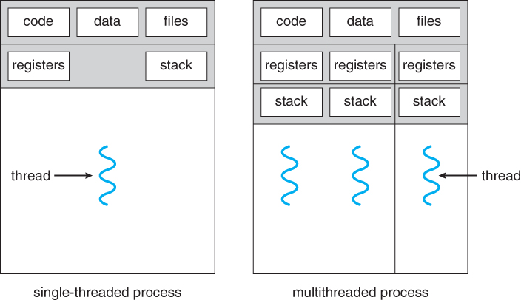
2. Threads
Overview

Slide 49
2. Threads
#include <pthread.h>
Linker option: -lpthread
Linux
To create a new thread, use the pthread_create function
Function signature:
– It takes as parameter a pointer to a thread ID, a pointer to a thread attributes structure, a pointer to a subroutine, and a pointer to the argument of the function (or to the structure in case of multiple arguments)

Slide 50
2. Threads
Linux
To stop the current thread, use the pthread_exit function
Function signature:
– It takes as parameter a pointer to the return status of the terminated thread

Slide 51
2. Threads
Linux
To wait for the termination of a thread, use the pthread_join function
Function signature:
– It takes as parameter a thread ID, and a pointer to the thread exit state

Slide 52
2. Threads
Linux
To detach a thread (do not require a join and release resources automatically after termination) , use the pthread_detach function
Function signature:
– It takes as parameter a thread ID

Slide 53
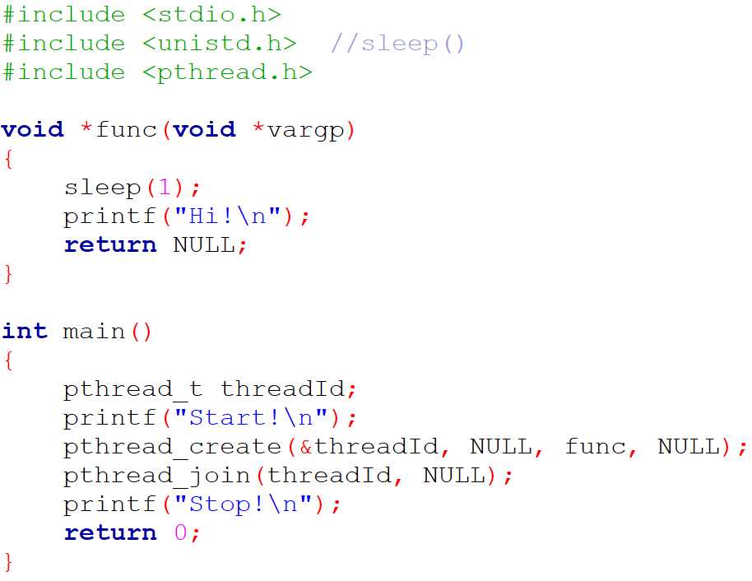
2. Threads
Linux

Slide 54
2. Threads
Linux
Mutexes are a lock system that guarantees the viability of the data manipulated by the threads
It often happens that several threads need to read/write the same variables
If a thread has the lock, only this one can read and write on the variables being in the protected portion of code (critical section)
When the thread has finished, it releases the lock, and another thread can pick it up

Slide 55
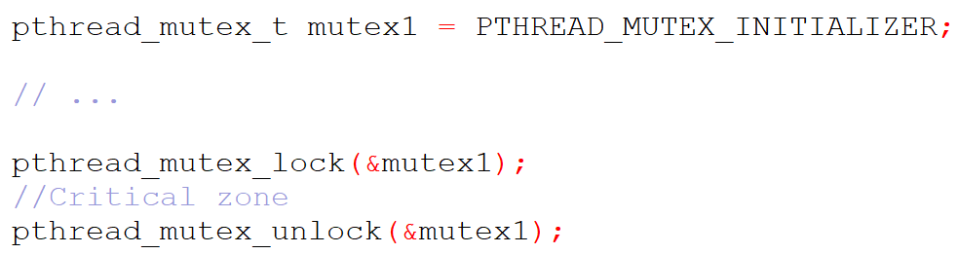
2. Threads
Linux

Slide 56
2. Threads
Linux
Semaphore is an integer variable initialized with the number of resources present in the system and used for process synchronization
Where mutex uses a locking mechanism, semaphore uses a signaling mechanism
A mutex object allows multiple process threads to access a single shared resource, but only one at a time; on the other hand, a semaphore allows multiple processes to access a finite instance of the resource until it becomes available
In mutex, the lock can be acquired and released by the same process at a time; the value of the semaphore variable can be modified by any process that needs some resource but only one process can change the value at a time
Notes:
Source: https://afteracademy.com/

Slide 57
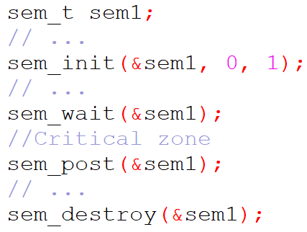
2. Threads
#include <semaphore.h>
Linux

Slide 58
2. Threads
#include <windows.h>
Windows
To create a new thread, use the CreateThread function
Function signature:
– It takes as parameter a pointer to the inheritance structure, a stack size, a pointer to a subroutine, a pointer to a thread attribute, an initial state, and a thread ID

Slide 59
2. Threads
Windows
To stop the current thread, use the ExitThread function
Function signature:
– It takes as parameter an exit code value

Slide 60
2. Threads
Windows
To wait for the termination of a thread, use the WaitForSingleObject function using INFINITE timeout
Function signature:
– It takes as parameter a thread handle, and a timeout interval

Slide 61
2. Threads
Windows
To close a thread handle or to detach a thread, use the CloseHandle function
Function signature:
– It takes as parameter a thread handle

Slide 62
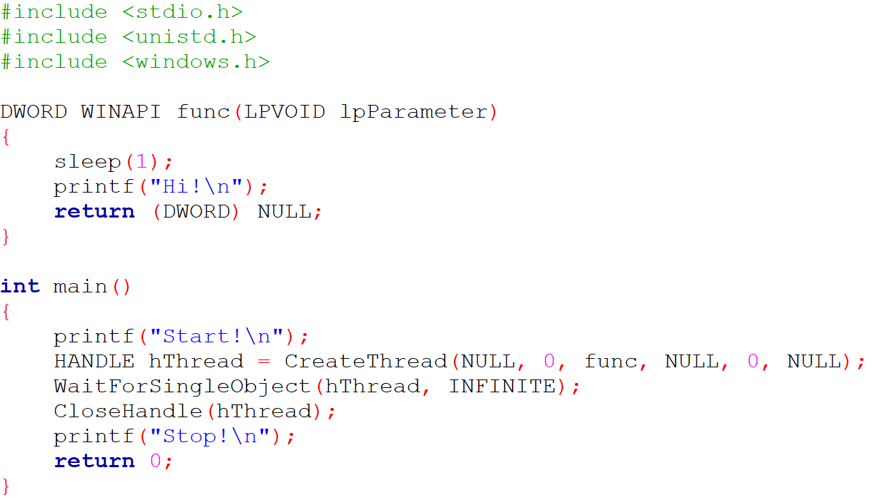
2. Threads
Windows

Slide 63
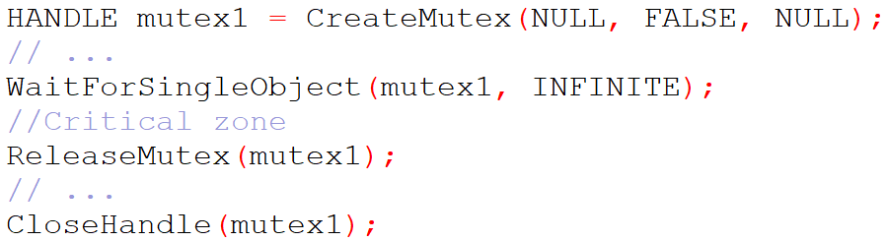
2. Threads
Windows
Mutexes:

Slide 64
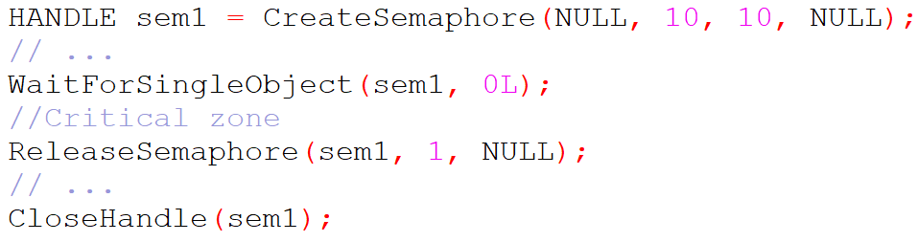
2. Threads
Windows
Semaphores:

Slide 65
2. Threads
Exercise
Start 10 threads simultaneously
Threads will have a certain duration in order to finish one every 5 seconds
The main thread will display the time as it goes along and then an end message

Slide 66
2. Threads
Questions

Slide 67

C Developer
Advanced Concepts
Thank you for your attention

